Slide 1



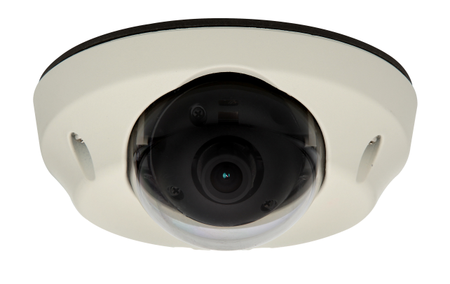
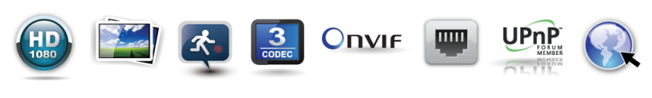
DWC-MPA20M
IP 2.1MP Armored Vandal Dome Camera
Before installing or operating the camera, please read and follow this manual carefully.
04132012

Slide 2
PRECAUTIONS
Do not open or modify.
Do not open the case except during maintenance and installation, for it may be dangerous and can cause damages.
Do not put objects into the unit.
Keep metal objects and flammable substances from entering the camera. It can cause fire, short-circuits, or other damages.
Be careful when handling the unit.
To prevent damages, do not drop the camera or subject it to shock or vibration.
Do not install near electric or magnetic fields.
Protect the camera from humidity and dust.
Protect the camera from high temperature.
Be careful when installing near the ceiling of a kitchen or a boiler room, as the temperature may rise to high levels.
Cleaning: To remove dirt from the case, moisten a soft cloth with a soft detergent solution and wipe.
Mounting Surface: The material of the mounting surface must be strong enough to support the camera.
FCC COMPLIANCE
This equipment has been tested and found to comply with the limits for a Class B digital device, pursuant to Part 15 of the FCC rules. These limits are designed to provide reasonable protection against harmful interference, when the equipment is operated in a residential environment. This equipment generates, uses, and radiates radio frequency energy, and if it is not installed and used in accordance with the instruction manual, it may cause harmful interference to radio communications.
WARNING: Changes or modifications are not expressly approved by the manufacturer.
2

Slide 3

TABLE OF CONTENTS*
Introduction.......................................................................................................................................................4
Features........................................................................................................................................................4
  Parts ............................................................................................................................................................5
Dimensions...................................................................................................................................................6
Inside the Box .............................................................................................................................................7
Installation.........................................................................................................................................................8
Network Connection.....................................................................................................................................8
Mounting the Camera.............................................................................................................................9-10
Adjusting the 2-Axis Gimbal.......................................................................................................................11
MEGAPIX Camera Setup...............................................................................................................................12
Installing the IP Finder...............................................................................................................................12
Using IP Finder Software......................................................................................................................13-14
Network Options.........................................................................................................................................15
Camera Reboot..........................................................................................................................................16
MEGAPIX Camera Web Viewer.....................................................................................................................17
Accessing the Web Viewer via Internet Explorer.......................................................................................17
Accessing the Web Viewer via Google Chrome, Mozilla Firefox and Safari............................................18
First & Second Stream...............................................................................................................................19
Export Image..............................................................................................................................................20
Print Image.................................................................................................................................................21
Panic Recording....................................................................................................................................22-23
MEGAPIX Camera Setup...............................................................................................................................24
Video ....................................................................................................................................................24-27
Event.....................................................................................................................................................28-30
Network.................................................................................................................................................31-36
System..................................................................................................................................................37-44
Specifications ...........................................................................................................................................45-46
Troubleshooting .......................................................................................................................................47-50
Warranty..........................................................................................................................................................51
Limits & Exclusions.......................................................................................................................................52
3

Slide 4
FEATURES*
ONVIF Conformant
1/2.7” CMOS Sensor (12% Larger than 1/3” CMOS Sensor)
Highest Resolution 2.1 Megapixels
1080P (1920X1080) at 30fps
4.3mm Fixed Lens
8X Digital Zoom
Power over Ethernet [PoE] & DC12V
Web Server Built-in
H.264 and MJPEG Dual Stream
Electronic Day and Night
3D-DNR (3D Digital Noise Reduction)
Programmable Privacy Zones (30) & Motion Detection
Mirror
E-mail Event Notifications
Max 20 Users
Panic Recording
Export & Print Image
IP66 Certified (Weatherproof)
4

Slide 5
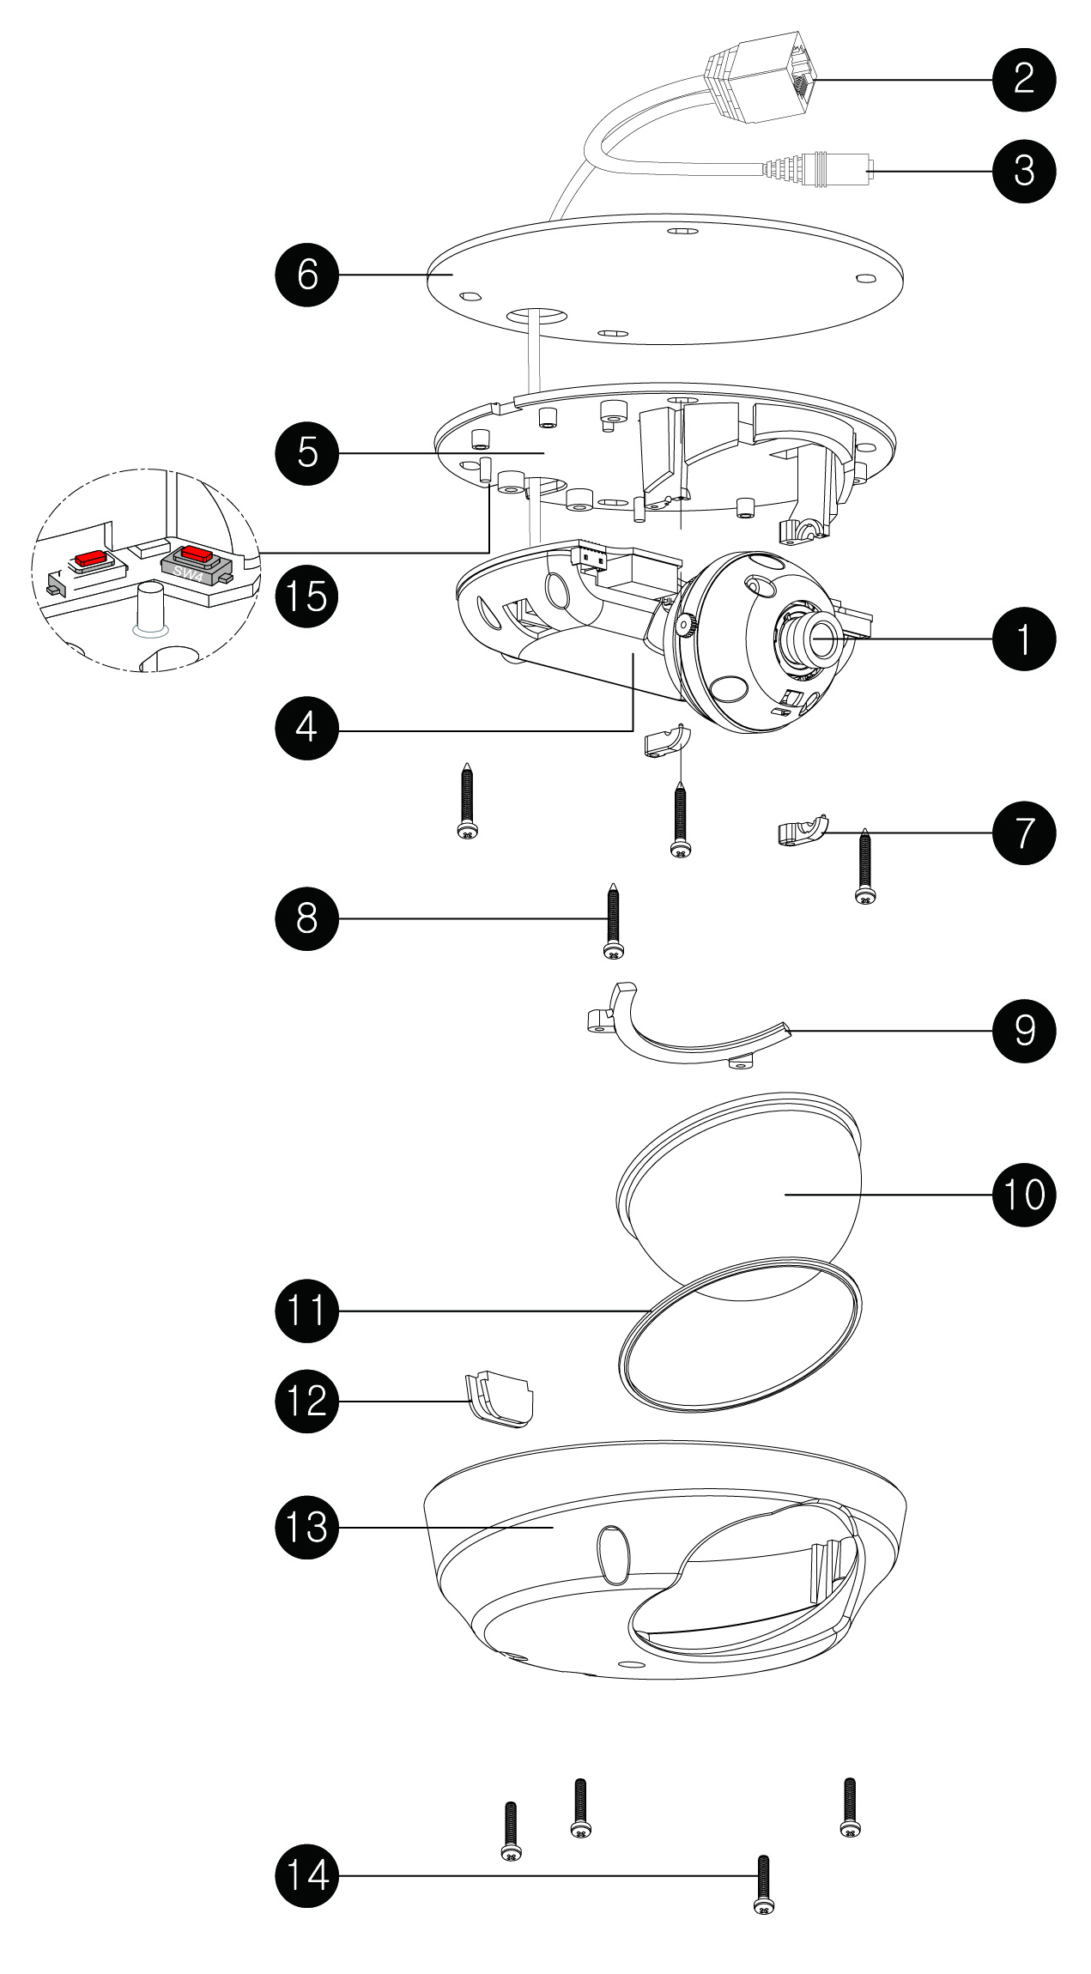
PARTS & DESCRIPTIONS*
Lens
RJ45 Cable
DC Cable
IP Module
Bottom
Bottom Pad
Gimbal Tilt Stopper
Mounting Screws
Dome Cover Support
Dome Cover
Gasket Rubber
Upper Case Rubber
Upper Case
Assembly Screws
M3.0 X 15.0
FA Buttons
5
5

Slide 6
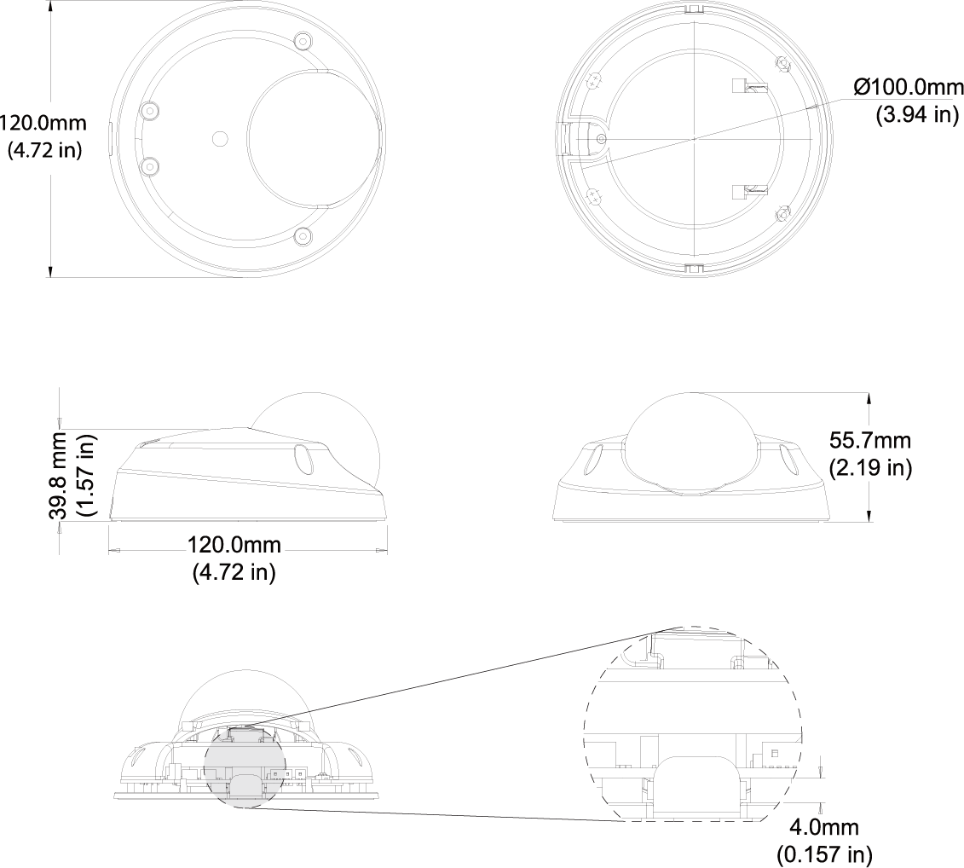
DIMENSIONS*
6

Slide 7
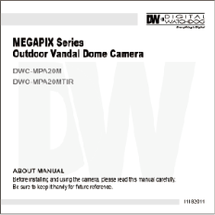
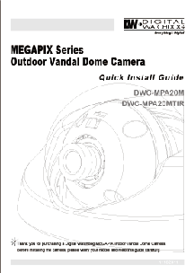
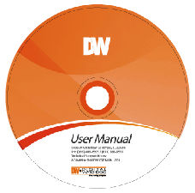


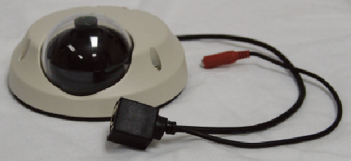
INSIDE THE BOX*
The following items are included with the MEGAPIX camera.
1
2
3
4
User Manual
Quick Start Guide
CD (Manual & Software)
L-Wrench (T10-M3X15.0)
4 Screws & 4 Dry Wall Anchors
Mounting Template
5
6
1
2
Camera Input Sensor
Power Supply DC12V
Max 5.16W, 430mA
RJ45 Connector
3
7

Slide 8
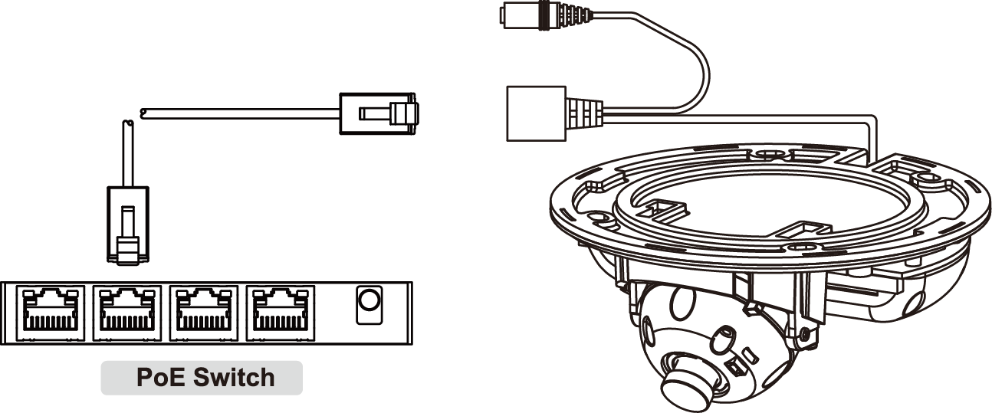
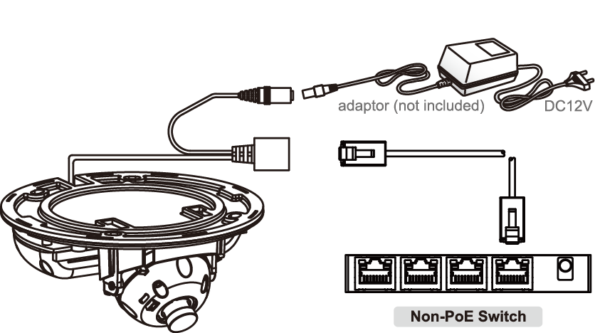
NETWORK CONNECTION *
There are two options.
Use a PoE-enabled switch to connect data and power through a single cable and begin viewing and recording images instantly. A non-PoE switch will require an adaptor for power transmission.
Using a PoE-Enabled Switch
The MEGAPIX Camera is PoE compliant, allowing transmission of power and data via a single Ethernet cable. PoE eliminates the need for the different cables used to power, record, or control the camera. Follow the illustrations below to connect the camera to a PoE-enabled switch using an Ethernet cable.
Using a Non-PoE Switch
If a PoE-enabled swithc is not u sed, use a power adaptor for power transmission and a non-PoE switch for data transmission. Follow the illustrations below to connect the camera without a PoE-Enabled Switch.
8

Slide 9
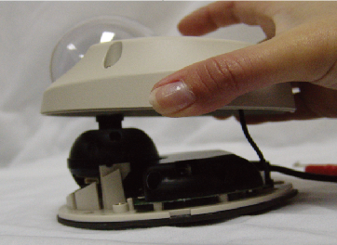
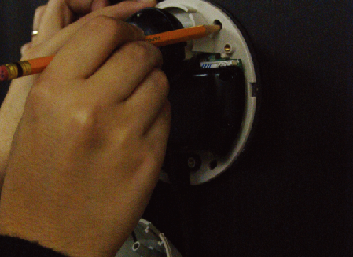
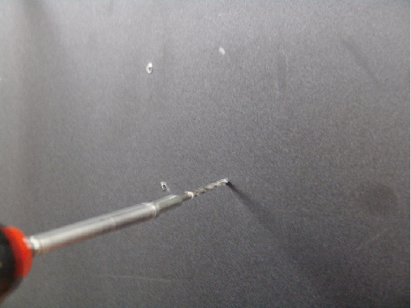
INSTALLATION*
1
2
Using the supplied L-Wrench (T10-M3X15.0), loosen the four security screws. Carefully remove the dome cover.
The MEGAPIX camera comes with a safety wire attached.
The Safety Wire will secure the dome cover to the camera module during the installation process. To remove the safety wire, remove the screw that is keeping the wire in place. We recommend that you use the safety wire.
3
4
Use the camera mounting template or your camera to mark the holes as required.
Drill the holes into the drywall and insert the drywall mounts into the holes.
9

Slide 10
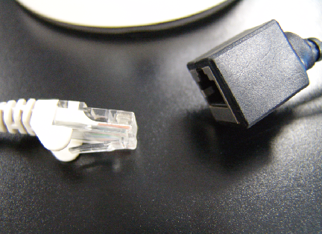
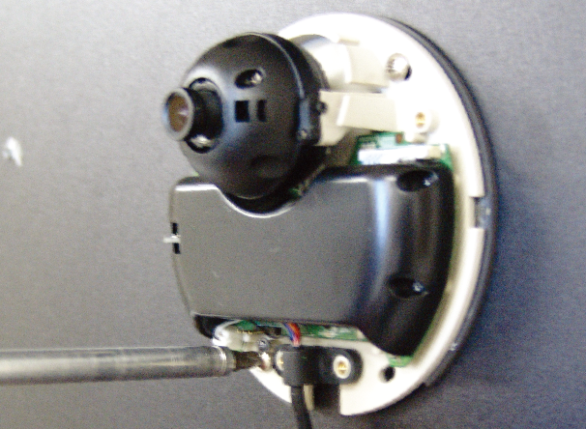
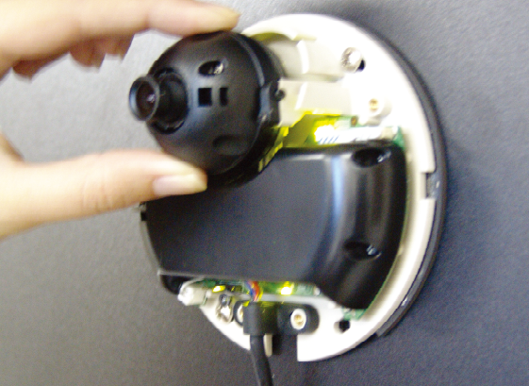
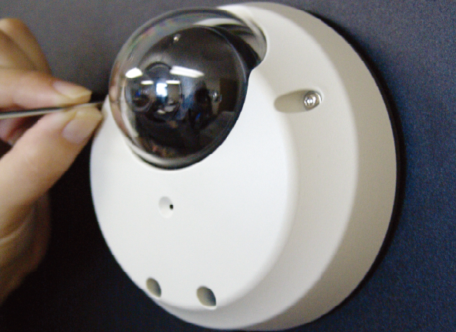
INSTALLATION*
5
6
Pull wires through and make connections. Connect the RJ45 to a CAT5 cable or power adaptor. Refer to “NETWORK CONNECTIONS” for further explanation.
Mount the camera to the wall or ceiling, using the screws provided with the camera.
7
8
Adjust the camera pan and tilt. See page11 for details. Check the LED light. Green light flickers when the camera is booting, and Red light turns on when booting is complete.
Tighten the four locking screws with the L-Wrench.
10

Slide 11
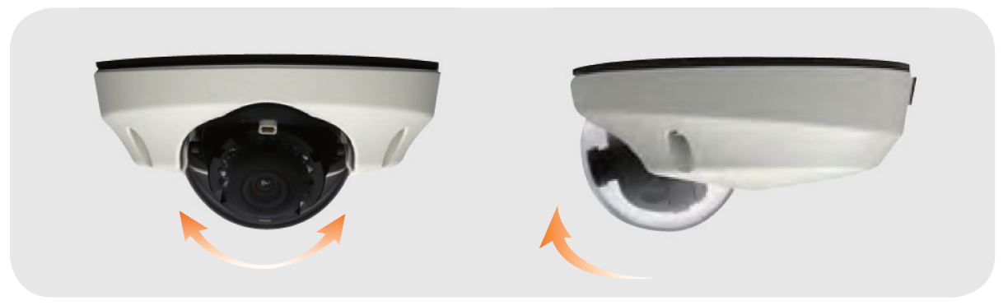
INSTALLATION*
Adjusting the 2-Axis Gimbal
The Gimbal mechanism yields maximum rotation and placement as shown below.
Pan 360º
Tilt 90º
11

Slide 12
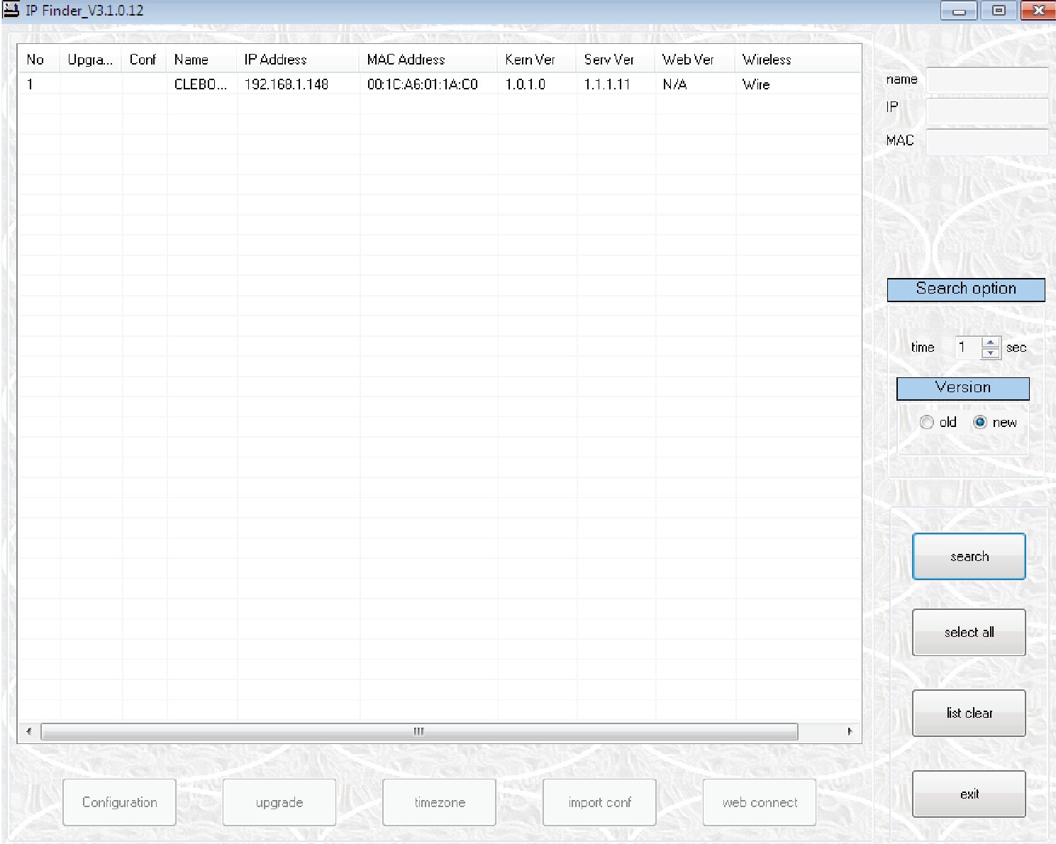
IP FINDER SOFTWARE*
Installing IP Finder Software
IP Finder searches for all the available Digital Watchdog devices currently connected to your network.
Install IP Finder to find the MEGAPIX camera on your local network. The software can be found on the included User Manual CD. Run IP Finder and install onto your PC.
When setup is complete, launch IP Finder .
To find your MEGAPIX camera, click Search button. Your MEGAPIX camera will appear as ”DWC-MP.”
Select the desired device and click Web Connect to access the camera directly via Internet Explorer.
*Make sure to install the IP Finder to a computer located on the same network segment (Subnet Mask) as the MEGAPIX camera.
12

Slide 13
IP FINDER SOFTWARE*
Using IP Finder Software
Use IP Finder to change the basic settings of your MEGAPIX camera or to connect to your MEGAPIX camera.
Configuration: Change the device’s connection type and/or IP address information. Please see the next page for further explanation.
Upgrade: Upgrade the device’s firmware.
Timezone: Change the timezone.
Import Config: Import setup configuration for a specific device.
Web Connect: Connect to the MEGAPIX camera through Internet Explorer.
1
2
3
4
5
13

Slide 14
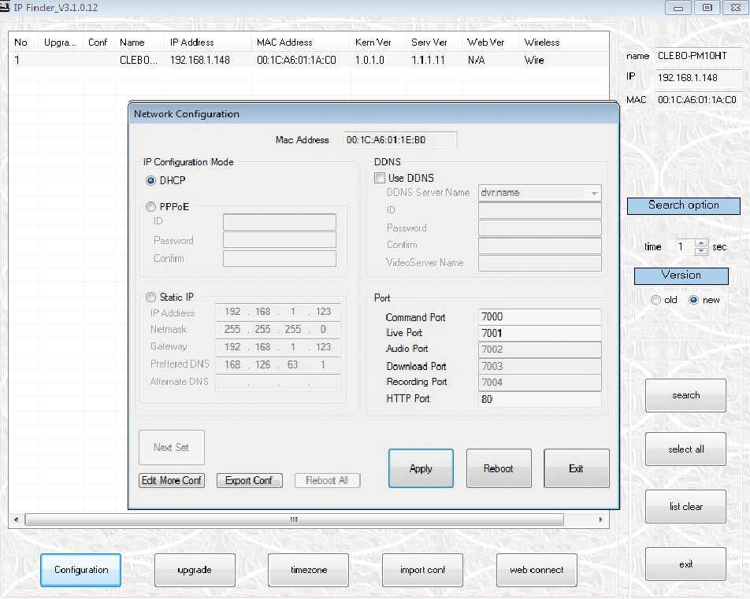
IP FINDER SOFTWARE*
Using IP Finder Software
Use IP Finder to set the connection type and the IP address information for your MEGAPIX camera.
DHCP: Select DHCP to access the camera within the same internal network. For further explanation on DHCP, please see PAGE 15.
Static IP: Select Static to connect to the camera from an external network. For further explanation on Static, please see PAGE 15.
Use DDNS: Check this option to use DDNS service. For further explanation on DDNS, please see PAGE 15.
Port: Displays the port numbers that are required for communication. User can use IP Finder to change other basic settings for your MEGAPIX camera.
(The menu will be different depending on the model.)
1
3
2
4
*If you decide to change the camera’s IP, make sure to write down the camera’s MAC Address for identification in the future.
14

Slide 15
IP FINDER SOFTWARE*
DHCP
The Dynamic Host Configuration Protocol (DHCP) is a network configuration protocol that allows a device to configure automatically according to the network it is connected to.
If your network supports DHCP and your MEGAPIX camera is set to DHCP, IP Finder will automatically find and set your MEGAPIX camera to correspond with your network requirements.
Static
Static IP addresses are recommended when using a network that does not support DHCP or when setting your device to be accessed externally via the internet. If Static is selected, you must manually enter the correct network settings for your MEGAPIX camera. The settings will correspond with your network. To set your camera to a static IP address, we recommend that you (1) setup the camera to DHCP, (2) allow it to configure itself according to your network, and (3) change the settings to a static IP address.
To set your MEGAPIX camera to Static, highlight the desired device from the search results list, and click on Configuration. In the “Network Configuration” window, make sure Static is selected.
Enter the following information: IP Address, Netmask, Gateway, and Preferred DNS.
Click Apply and Reboot to save all changes.
DDNS
Dynamic Domain Name Server is a feature that allows you to use a specific URL instead of an IP address to access your MEGAPIX camera. This feature is optional. It may require a subscription and fee.
To use the DDNS feature, check the box next to Use DDNS.
Select the server you wish to use. *Some servers may require a subscription and fee.
If applicable, enter the User ID and Password.
Click Apply and Reboot to save all changes.
15

Slide 16
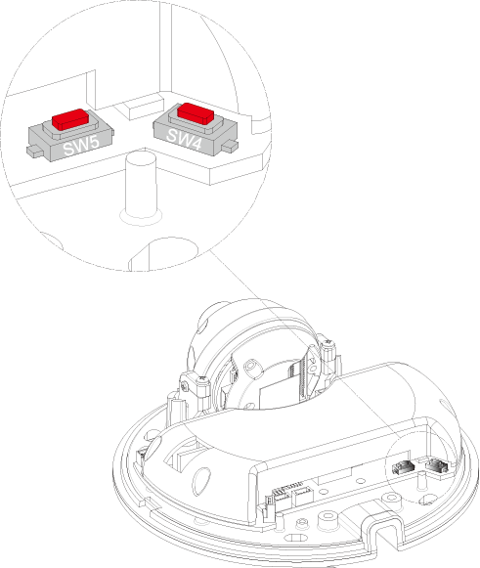


CAMERA REBOOT*
Resetting the Camera
Hold down SW4 and press SW4 to initialize all environmental variables to factory default. Previous setup (IP default, time, etc) will be deleted. If a system’s IP address is lost, reset the camera back to factory default.
The following are the default network settings.
SW5 Camera Reboot
SW4 Factory Default
IP Mode | DHCP
IP Address | 192.168.1.123
Subnet Mask | 255.255.255.0
Gateway | 192.168.1.23
Command Port | 7000
HTTP Port | 80
Live Port | 7001
*Frequent use may cause system error.
16

Slide 17
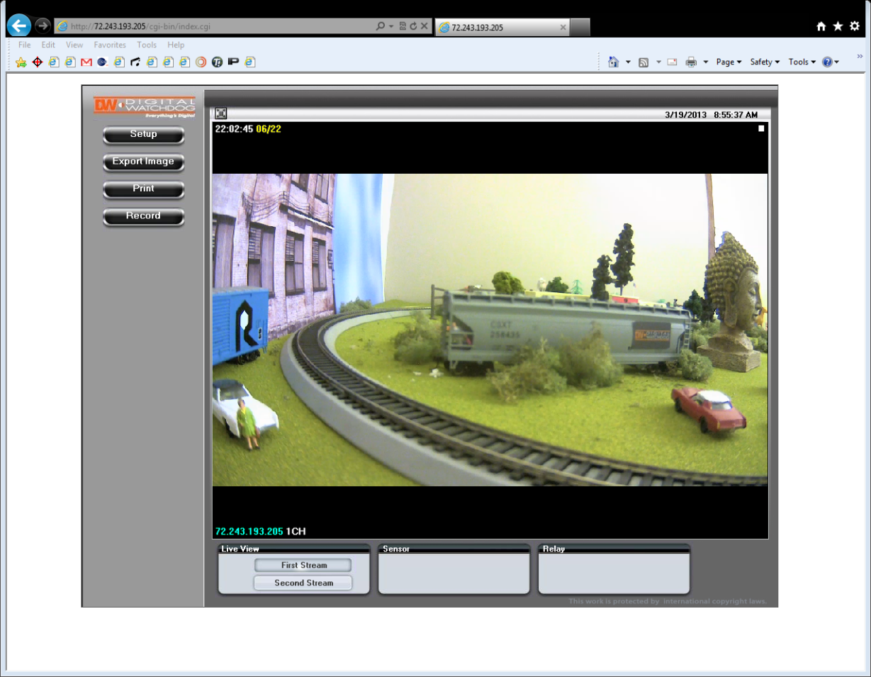
WEBVIEWER*
Remote Video Monitoring Via Internet Explorer
Monitor and configure the MEGAPIX camera through a built-in webviewer.
Type the IP address of the camera on the Internet Explorer window.
Example: http://192.168.1.123 (Factory Default)
Enter Username and Password
Username: admin | Password: admin
The web browser will ask to install ActiveX Control. Once it has been installed, Internet Explorer will display video images from the camera.
17

Slide 18
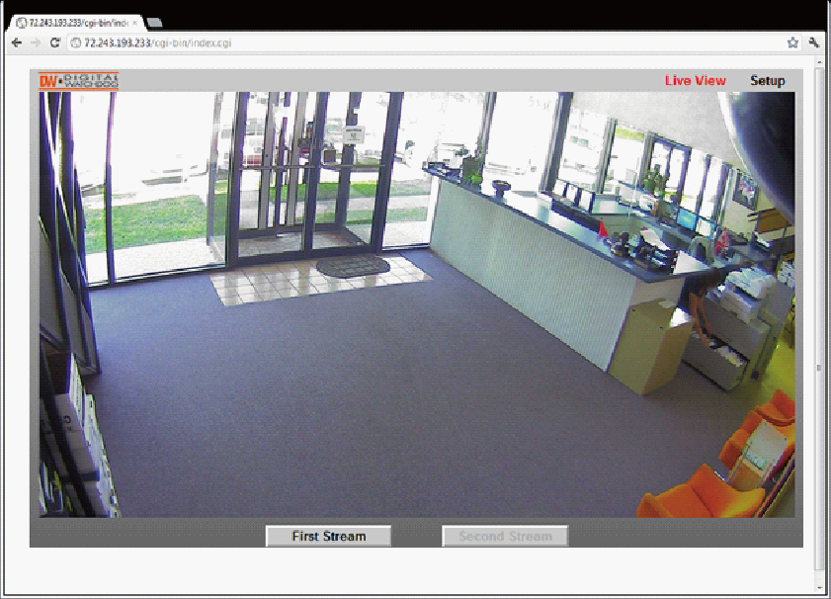

WEBVIEWER*
Remote Video Monitoring Via Chrome, Firefox, or Safari
You can view your MEGAPIX camera using web browsers other than Internet Explorer. To do so, at least one of the streams of the camera must be set to the codec MJPEG.
Open Google Chrome, Mozilla Firefox, or Apple Safari Web Browser.
Enter the IP camera's IP address. If the first stream is set to H.264; then a video will not be displayed on the GUI.
Click the Setup button located at the top right of the page. Then go to Video > Stream Settings.
Modify one of the two (2) streams to the codec MJPEG.
When you are finished modifying the streams, click Apply and Reload to make sure all changes have been saved and your camera has been rebooted.
Click on Live View to return to the camera’s main page.
At the bottom of the page, select the stream you set as MJPEG. The camera will begin streaming video.
18

Slide 19
WEBVIEWER*
First Stream & Second Stream
Configure two stream settings for monitoring and recording.
On the main monitoring page, user can view the camera with the First Stream settings or the Second Stream settings. Below the display screen, click on the First Stream and Second Stream buttons to view the different camera settings.
To Setup Stream Settings, refer to PAGE 24.
19

Slide 20
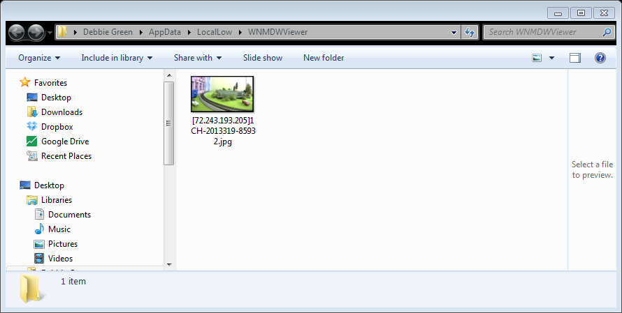
WEBVIEWER*
Export Image
Export a screenshot of the current live video to your computer.
Click Export Image button located on the left. “Save As” window will appear.
A .jpg image will automatically be stored under a WNMDWViewer folder.
The image’s name will include the camera’s IP address, Channel name, and date and time.
20

Slide 21
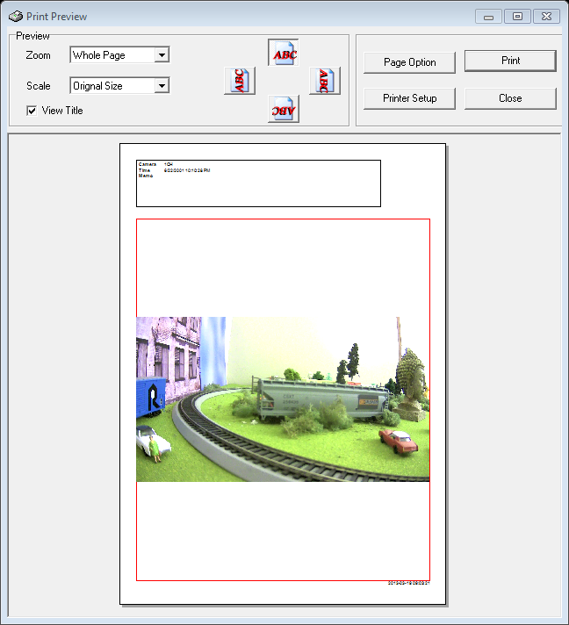
WEBVIEWER*
Print Image
Print a screenshot of the current live video.
Click Print button, and the Print Preview window will appear.
Scale the size of the screenshot or adjust the orientation of the screenshot.
To print the information about the screenshot, select View Title. To add a memo for the screenshot, click Page Option.
Go to Printer Setup to select the printer and manage the printer properties.
Select Print to print the page, or Close to cancel the print.
21

Slide 22
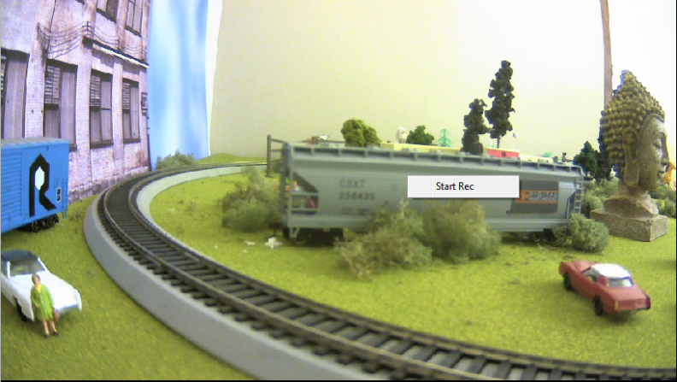
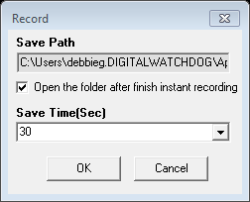
WEBVIEWER*
Instant Recording
Record live video to your local drive.
To Setup Instant Recording
Click on the Record button located to the left of the Webviewer.
Setup where you want the videos to be saved.
Setup the duration of the instant recording. You can record up to 120 seconds of live video.
When setup is complete, click OK to save changes or Cancel to cancel any changes.
22

Slide 23
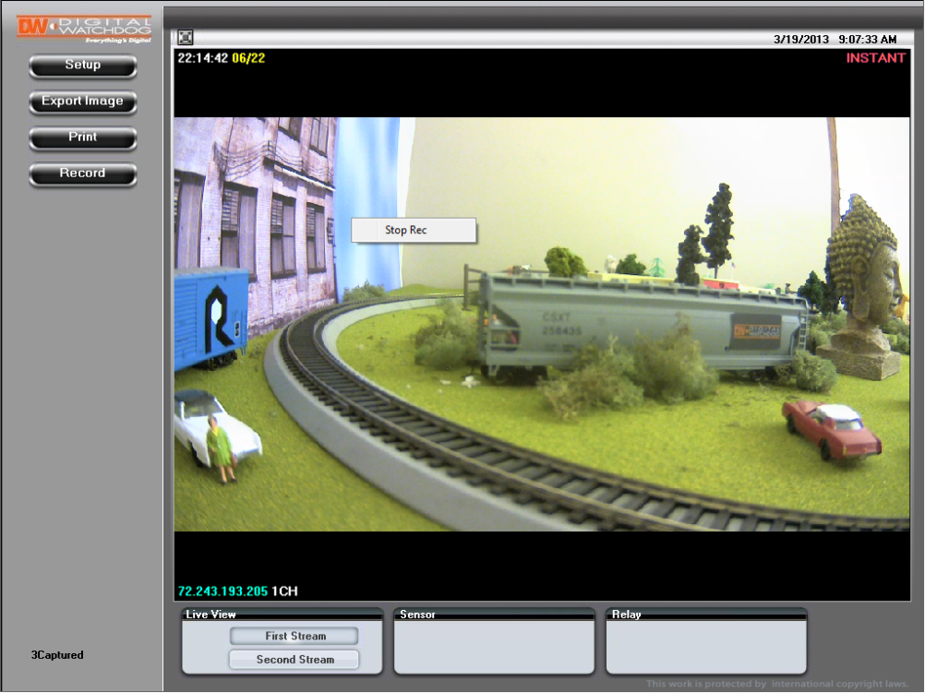
WEBVIEWER*
Instant Recording
Record live video to your local drive.
To Start and Stop Instant Recording
To Start, right-click anywhere on the display screen.
Click on Start Rec. The icon on the top right of the screen will change to INSTANT.
To Stop, right-click anywhere on the display screen.
Click on Stop Rec. The video will be displayed in the designated folder when recording is complete.
23

Slide 24
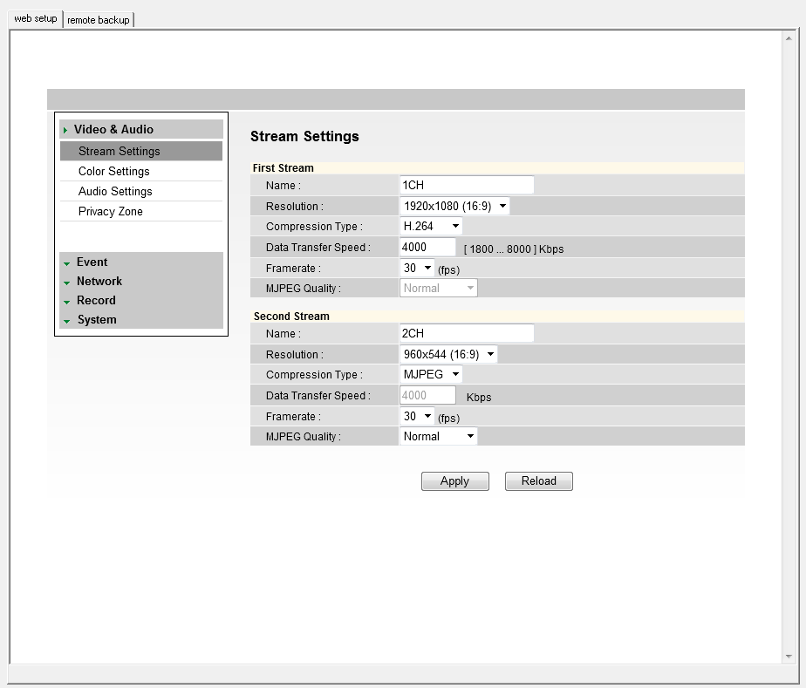
WEBVIEWER*
Setup > Video > Stream Settings
The Recommended Stream Settings are indicated on the image to the left. This is also the factory default settings.
Name: Set a distinguished name to each stream to identify each.
Resolution: Set Resolution for each stream. The better the resolution of the video, the more bandwidth it will require to stream images.
Compression Type (Codec): Select the type of compression to use when outputting the video.
Data Transfer Speed: Set encoding bitrate if H.264 and MPEG4 compression type is selected.
Framerate: Select from 0fps to 30fps.
MJPEG Quality: Set MJPEG image quality. This is only available when the compression is set to MJPEG. The higher the quality, the more bandwidth will be required to stream the image.
Select Apply to save changes.
1
2
3
4
5
6
7
24

Slide 25
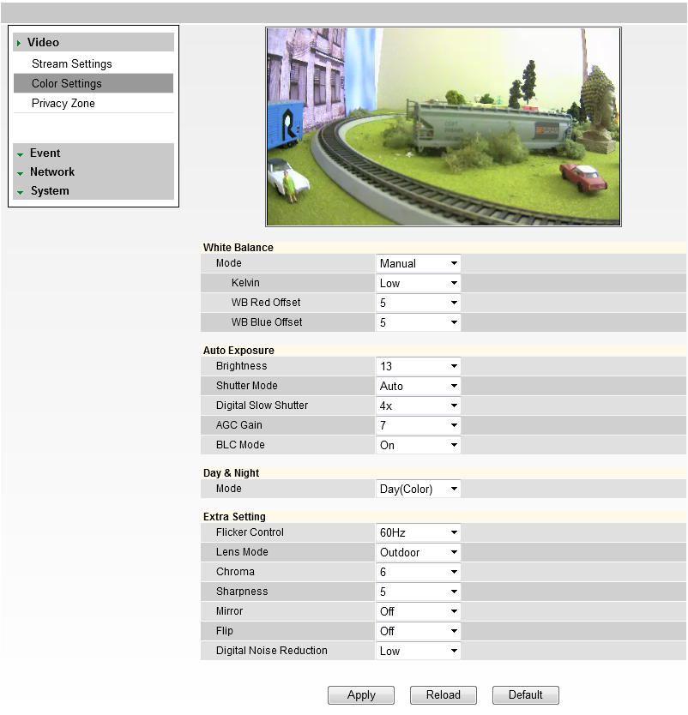
WEBVIEWER*
Setup > Video > Color Settings
Initially, the factory default settings will appear; however, you may customize the Color Settings for your MEGAPIX camera.
White Balance: Mode - Also known as Color Balance. This gives the camera a reference to “true white.” Select from Auto, Auto_H, Auto_L, Preset, or Manual.
Auto Exposure: Set Brightness, Shutter Mode, Digital Slow Shutter, Shutter Speed, AGC Gain, and BLC Mode.
1. Brightness: Select from 0 (darkest) to 20 (brightest).
2. Shutter Mode: Set the amount of light allowed in the video manually or automatically.
3. Digital Slow Shutter: Recommended in
low light conditions. Turn On (2x, 3x,
4x) or Off.
4. AGC Gain: Maximum light gain
settings in low light conditions. Select
from 0 (least light) to 20 (most light).
BLC Mode: In this menu you
can select to enable or disable
Backlight Compensation to adjust the
image in harsh lighting environments.
Select ‘Apply’ to save changes,
‘Reload’ to return to the last saved
settings, or ‘Default’ to return all
settings to their factory default values.
25

Slide 26
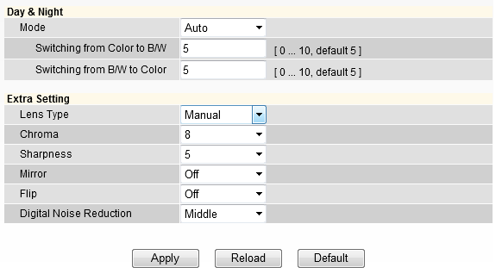
WEBVIEWER*
Setup > Video > Color Settings
Initially, the factory default settings will appear; however, you may customize the Color Settings for your MEGAPIX camera.
Day & Night: Set the mode to Night (B/W), Day (Color), or Auto. If set as Auto, set a desired Color to B/W Level and B/W to Color Level.
1. Switching from Color to B/W: Select from 0~10. The higher the number, the less darker the environment will have to be for the camera to switch from color to B/W.
2. Switching from B/W to Color: This number should always be lower than the number set to color to B/W.
Extra Settings: Set Lens Type, Chroma, Sharpness, Mirror, Flip, and Digital Noise Reduction.
3. Lens Type: Set the camera to an indoor or outdoor lighting environment. Select Manual, DC, or AF.
4. Chroma: Affect the quality of the color in the image. Select from 0~20. The higher the number, the brighter the color in the video.
5. Sharpness: Select sharpness from 0~10 of the image.
6. Mirror/ Flip: Select On or Off to mirror the image from left to right, or flip it upside down.
7. Digital Noise Reduction: Control the level of noise in the image. Select from Off, Low, Middle, or High.
8. Select Apply to save changes.
2
1
3
4
5
6
7
8
26

Slide 27
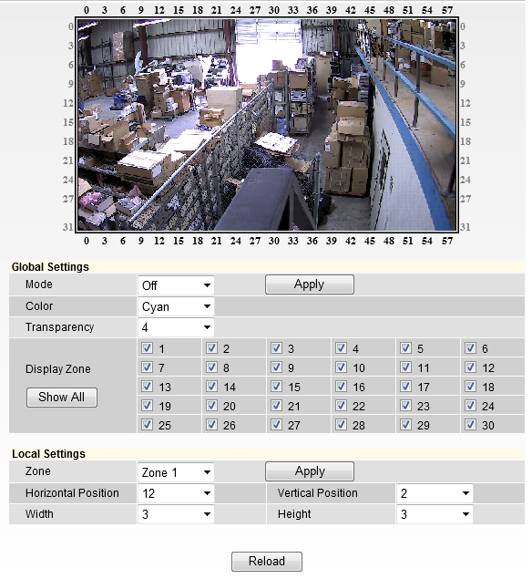
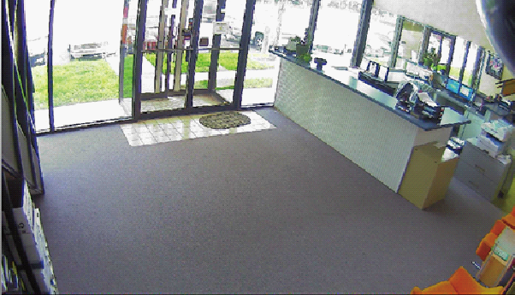
WEBVIEWER*
Setup > Video > Privacy Zone
The MV421 MEGAPIX camera offers up to 30 privacy zone settings. To set Privacy Zones:
Change Mode to On. Click Apply. By default, all 30 privacy zones will be displayed.
Select the color of the zone and transparency of the color from the drop down list. Click Apply.
Select the zones you want to view and/or modify. Use the Show All button to display all 30 privacy zones, or Hide All to deselect them and select only a single privacy zone. After selecting the privacy zone you want to modify, click Apply.
Set the zone’s size and location, using the grid lines. In Local Settings, select the zone you
want to modify, then select the position: Horizontal Position: 0~57; Vertical Position: 0~31; Width: 0~60; Height: 0~34.
Click Apply after each modification
to verify the size and position
match your requirements.
1
2
3
4
27

Slide 28
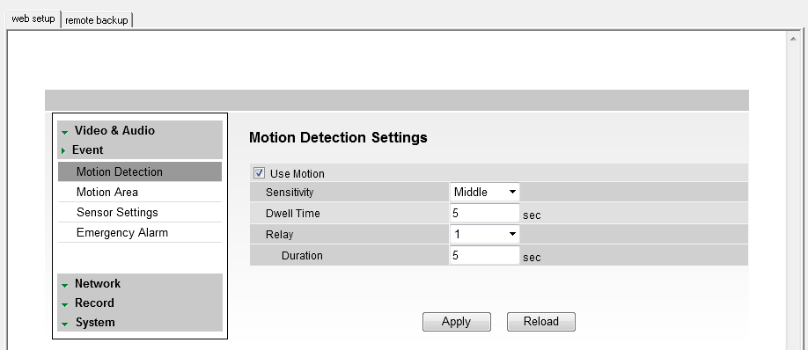
WEBVIEWER*
Setup > Event > Motion Detection
The Motion detection feature allows the MEGAPIX camera to detect motion and trigger an alarm. To set the camera to send e-mail notifications for every motion triggered alarms, see page 50.
Check the Use Motion box.
Sensitivity: Select from Low, Middle, or High.
Dwell Time: When a motion is triggered, the camera can be set to record for a certain period of time. Dwell Time can be set up to 900 seconds.
Relay: an alarm out triggered by motion detection. Select None or 1.
Duration: determines how long the alarm out will last. Maximum is 900 seconds.
Select Apply to save changes.
To setup specific areas of the camera’s view to motion detection, please see the next page.
1
2
3
4
5
6
28

Slide 29
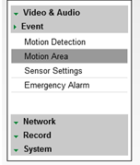
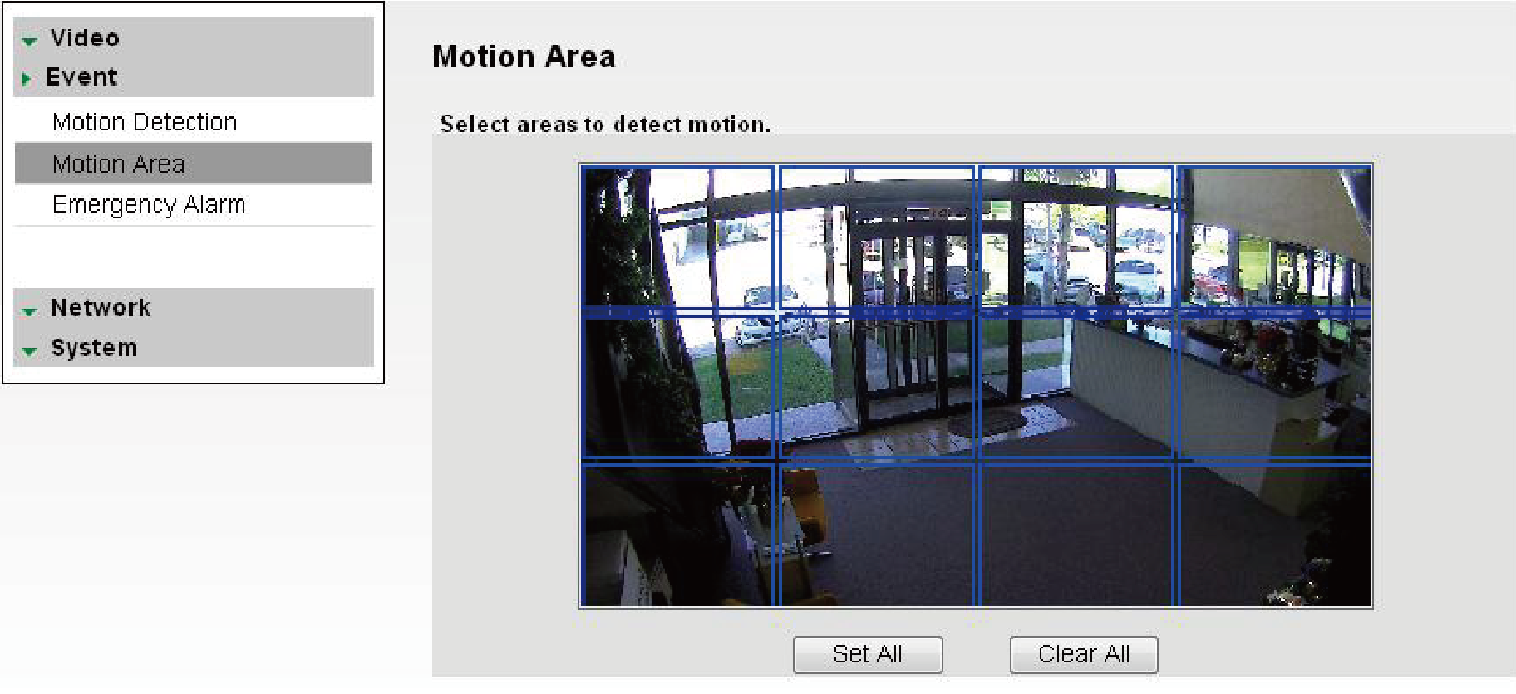
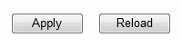
WEBVIEWER*
Setup > Event > Motion Area
The Motion detection feature allows the MEGAPIX camera to detect motion and trigger an alarm. To set the camera to send e-mail notifications for every motion triggered alarms, see page 50.
Hold left mouse button and drag the mouse pointer over image to select the motion area, or use Set All button to select the entire screen.
Select Clear All to deselect motion areas.
Select Apply to save changes.
1
2
3
29

Slide 30
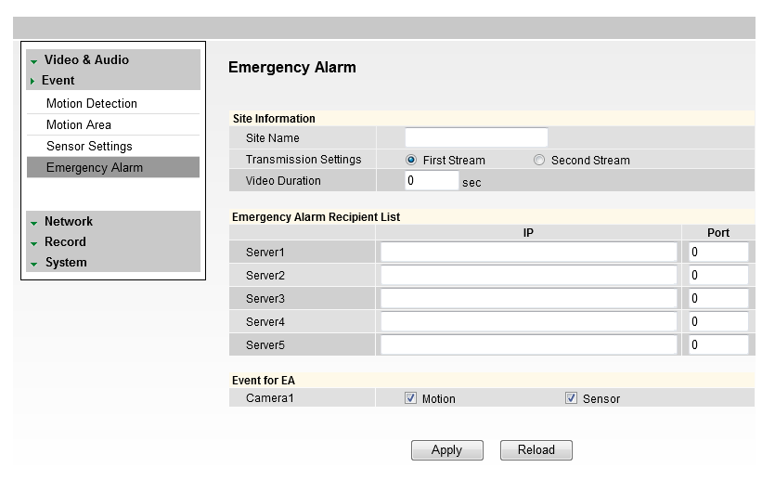
WEBVIEWER*
Setup > Event > Emergency Alarm
Send alarm triggered information to predefined destination (i.e. remote client software).
Site Information: Site Name, Transmission Settings, and Video Duration for the video that will be sent when motion is detected.
Emergency Alarm Recipient List: Enter the IP address and the Port for the remote site(s) to which you want to send the video. You can set-up up to five different servers. You must set same port to get EA data.
Event for EA: Select which type of event will trigger the alarm – Motion or Sensor.
Select Apply to save changes.
1
2
3
4
30

Slide 31
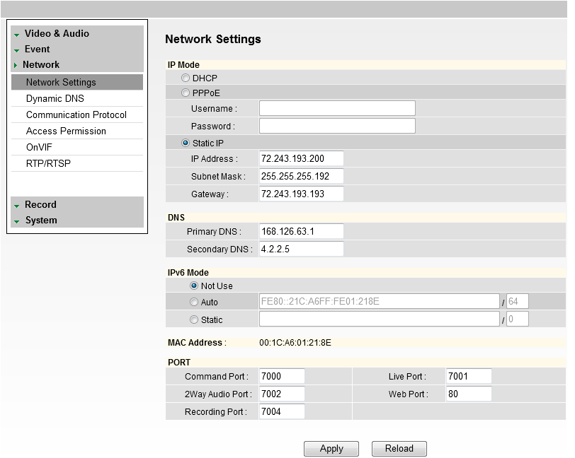
WEBVIEWER*
Setup > Network > Network Settings
IP Mode: Select the type of IP address for the camera.
DHCP: Select this option if you have a DHCP Server in your network and would like your camera to obtain an IP address automatically.
PPPoE: Select this option when you use WAN service. To use WAN service, you will need a Username and Password from your Internet Service Provider.
Static IP: Enter IP information on existing field if you decided to give the camera a static (fixed) IP address.
  IP Address: Enter the static IP Address of the camera
  Subnet Mask: default is 255.255.255.0
  Gateway: The gateway is your router’s external (public) IP address. It is used when accessing the camera from outside the network. The router will channel your data to the correct destination even if it is on a different subnet mask.
  To obtain a static IP Address and network information (Subnet Mask, Gateway, & DNS), please contact your Internet Service Provider or Network Administrator.
DNS: Enter Primary DNS and Secondary DNS. The Primary Domain Name Server translates web addresses to IP addresses. The Secondary DNS offers a backup option to the primary DNS.
IPv6 Mode: IPv6 offers a new 128-bit address
system. You can use it to use an Automatic
address generated by the network, or you
can manually enter a Static address.
MAC Address: Displays the camera’s MAC
(Mobile Access Control) Address.
PORT: Displays all the ports necessary for
network communication.
Reboot your system to apply the changes to
your camera. To Reboot, select Apply. A
dialogue box will appear, select OK.
System will automatically restart and may
take up to 20 seconds to reboot.
1
2
3
5
4
6
31

Slide 32
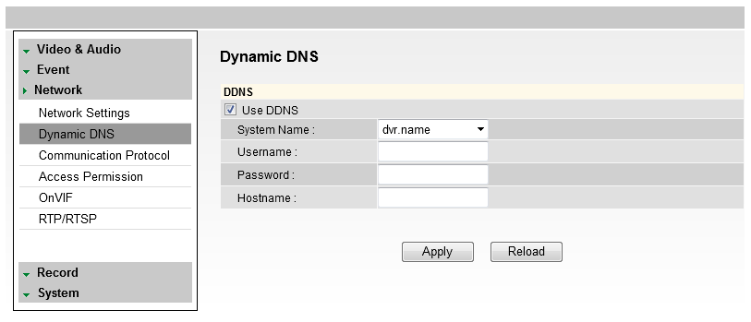
WEBVIEWER*
Setup > Network > Dynamic DNS
If you do not use a public IP address, DDNS provides you to connect on WAN. DDNS allows you to connect to the MEGAPIX camera with a URL address instead of an IP address. DDNS automatically redirects traffic to your IP address every time it changes.
To use DDNS, select the Use DDNS checkbox.
Select one of the DDNS System Names from the drop down list.
Enter Username & Password. The Username & Password must be registered at the DDNS site.
Enter Host Name.
Reboot your system to apply the changes to your camera. To Reboot, select Apply. A dialogue box will appear, select OK. System will automatically restart and may take up to 20 seconds to reboot.
1
2
3
4
5
32

Slide 33
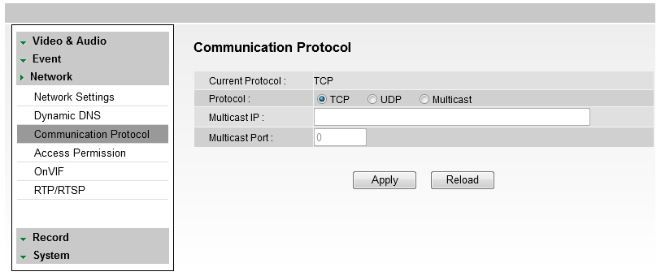
WEBVIEWER*
Setup > Network > Communication Protocol
Current Protocol displays the current selected protocol.
To change the Protocol, select one of the three options—TCP, UDP, or Multicast.
If you select Multicast, enter the Multicast IP and Multicast Port.
Reboot your system to apply the changes to your camera. To Reboot, select Apply. A dialogue box will appear, select OK. System will automatically restart and may take up to 20 seconds to reboot.
1
2
3
33

Slide 34
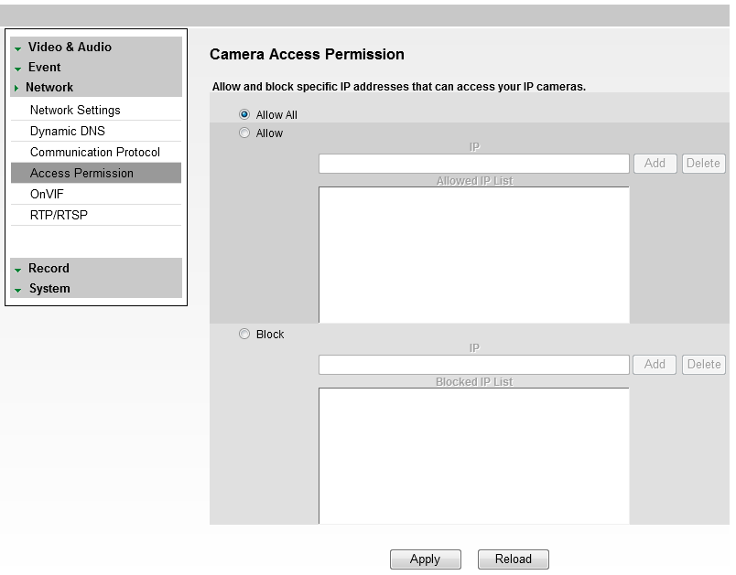
WEBVIEWER*
Setup > Network > Access Permission
Use the Access Permission page to allow or block specific IP addresses to connect to the camera.
Select Allow All to allow anyone to connect to this camera. If Allow All is selected, the Allowed IP List and Blocked IP List will be ignored.
To allow only a specific list of IP addresses to connect to this camera, select Allow. Enter an IP Address and click the Add button.
To block a specific list of IP addresses from connecting to this camera, select Block. Enter an IP Address and click the Add button.
1
2
3
34

Slide 35
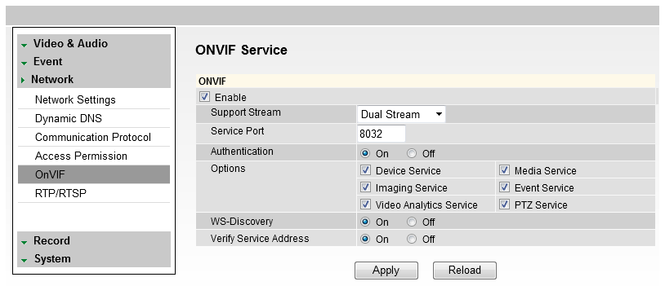
WEBVIEWER*
Setup > Network > OnVIF
OnVIF is the Open Network Video Interface Forum.
To use OnVIF, check Enable.
Set the Service Port to “8032.”
Select On or Off for WS-Security.
Select desired Options from the list.
Select On or Off for WS-Discovery (Web Services Dynamic Discovery)
Select On or Off to Verify Service Address.
Select Apply to save changes.
1
3
2
4
6
5
7
35

Slide 36
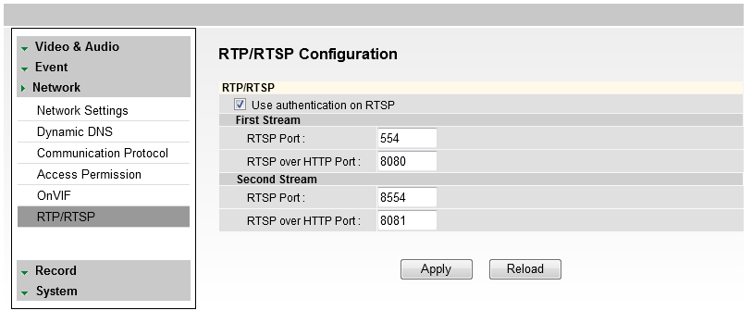
WEBVIEWER*
Setup > Network > RTP/ RTSP
RTP and RTSP Ports Configuration and Management
Realtime Transport Protocol (RTP) and Realtime Streaming Protocol (RTSP) are data transfer protocol for delivering live and stored media to one or more clients at the same time. These protocols allow software to access the first and second stream directly, by assigning each stream its own ports. RTP and RTSP are used for integration and communication between the cameras and other software.
To use RTP/ RTSP:
Check the box to enable authentication on RTSP
If necessary, modify the ports for the first and second stream.
Click ‘Apply’ so save all changes or ‘Reload’ to view the last saved settings.
1
2
3
36

Slide 37
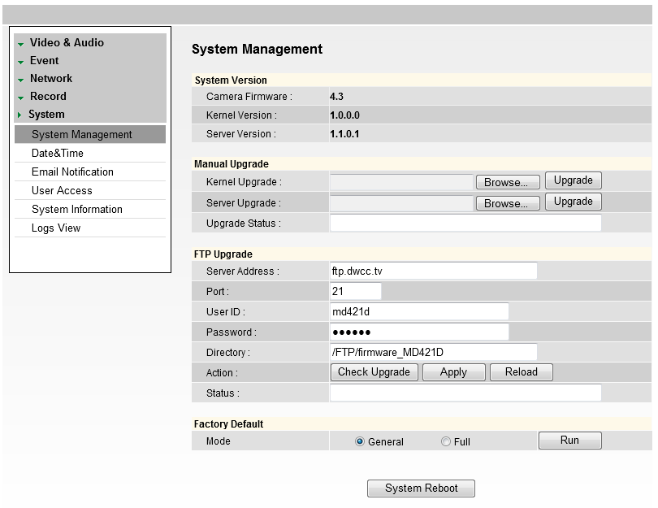
WEBVIEWER*
Setup > System > Upgrade
Upgrade the MEGAPIX camera with an upgrade file.
System Version: Shows the current version of the camera.
Manual Upgrade: To upgrade system firmware, you have to contact manufacturer and get the upgrade file first. Go to www.Digital-Watchdog.com and select Support tab.
  a. Browse file and select the file.
  b. Press Upgrade button. A dialogue box will appear. Select OK. System will automatically reboot.
1
2
3
37

Slide 38
WEBVIEWER*
Setup > System > Upgrade
Upgrade the MEGAPIX camera with an upgrade file.
FTP Upgrade:
a. Server Address: FTP Server IP address
b. Port: Default is 21
c. User ID: FTP Server Log in ID
d. Password: FTP Server Log in Password
e. Directory: Upgrade File Path
f. Action: Select Check Upgrade to display the Upgrade File list
g. Status: Display progress of the Upgrade
h. If camera detects an upgrade, a dialogue box will appear. Select OK. System will
automatically reboot.
1
2
3
38

Slide 39
WEBVIEWER*
Setup > System > Upgrade
Upgrade the MEGAPIX camera with an upgrade file.
Factory Defatult: You can reset the camera to its original factory settings.
Selecting the ‘General’ option will reset the camera to factory default on all settings except for the IP and Network configuration.
Selecting the ‘Full’ will reset ALL of the camera’s setting, including the network configurations.
1
2
3
39

Slide 40
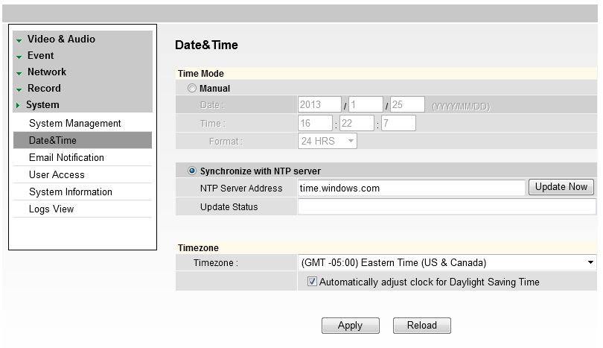
WEBVIEWER*
Setup > System > Date & Time
Set date and time information.
Insert the Date and Time. Select the type of Format for your time.
To synchronize with the NTP Server, select the option and type the NTP Server Address.
Example: pool.ntp.org.
Select your Time Zone.
Select Apply to save changes.
1
2
3
4
40

Slide 41
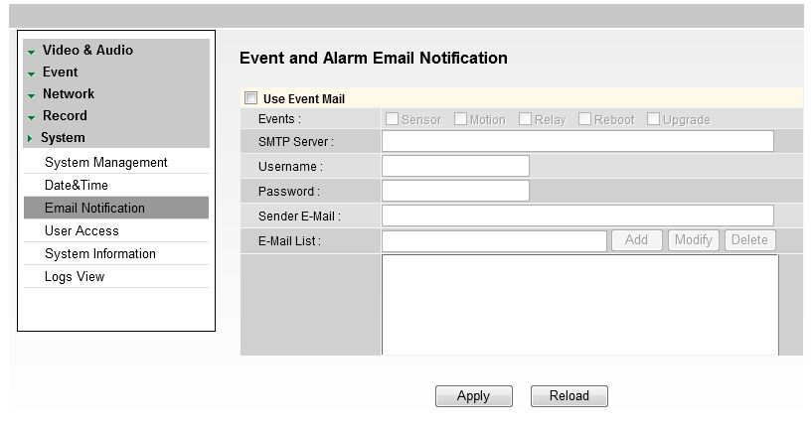
WEBVIEWER*
Setup > System > E-mail Notification
Send an e-mail notification when an event is triggered.
Select Use Event Mail option. Select Event Type.
Enter SMTP Server information. Example: smtp.gmail.com.
Enter Username and Password.
Enter Sender E-mail.
Add the E-mail(s) you wish to send the notifications to.
Select Apply to save changes.
1
2
3
5
4
6
*Email Notifications do not support TSL/SSL option. Notifications are TEXT only.
41

Slide 42
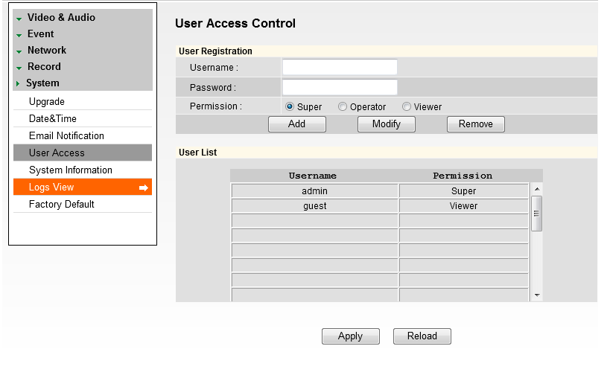
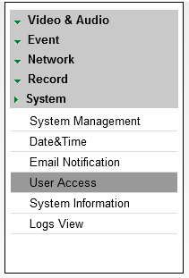
WEBVIEWER*
Setup > System > User Access Control
To add a new user:
Enter Username and Password.
Select a Permission type.
  Super: Administrator
  Operator: View and Edit Video and Event Settings Only
  Viewer: View Only
Click Add.
Select Apply to save changes.
To modify a user, select the user from the User List, and click Modify.
To remove a user, select the user from the User List, and click Remove.
1
2
3
4
*The maximum number of users who can be added to the User List is twenty.
42

Slide 43
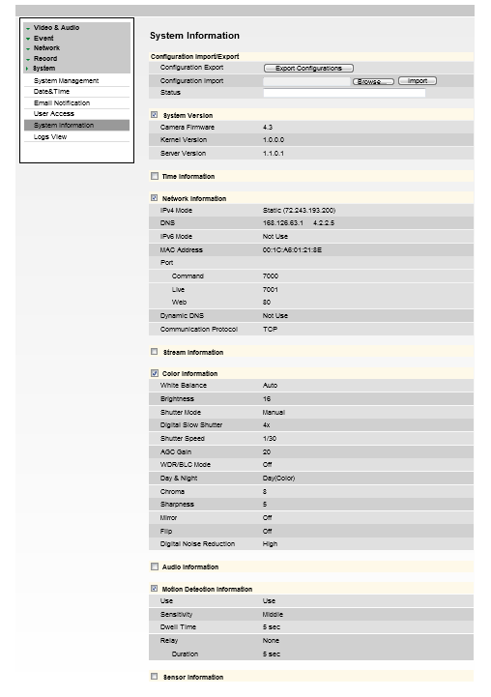
WEBVIEWER*
Setup > System > System Information
System Information will display all the current camera settings: System Version, Time Information, Network Information, and Stream Information.
You can export a camera’s settings to apply to
other cameras by using the import/ export buttons
on this page.
To Export the settings from the current camera:
Press the export button. The system will
generate a ‘.bin’ file with all the cameras
settings in your Internet Explorer ‘Downloads’
page.
To import settings from a different camera
Press the Browse button and locate the ‘.bin’ file
you have imported from a different camera.
Select the ‘Import’ button. The system will update
the current camera’s settings with all the imported
information.
The progress bar will display the import process.
43

Slide 44

WEBVIEWER*
Setup > System > Logs View
User can view detailed logs for system and/or events triggered and recorded in the camera.
To view, select the type of report you want to view: System, Event, or System & Event.
Select View.
The system will generate a report up to 140,000 bits of data.
  For events to record, make sure the camera is set to record when an event, like motion detection, is triggered. See page 35 for information on how to set motion detection for the MEGAPIX camera.
1
2
3
44

Slide 45
SPECIFICATIONS*
IMAGE
Image Sensor | 1/2..8” CMOS Sensor (7% Larger Than 1/3” CCD)
Total Pixels | 2016 (H) X 1108 (V)
Minimum Scene Illumination | F1.6 (30IRE): 0.8 Lux [Color] | F1.6 (30IRE): 0.01 Lux [B/W]
LENS
Focal Length | 4.3mm
Lens Type | Fixed
NETWORK
LAN | 802.3 Compliance 10/100 Lan
Video Compression Type | H.264, MPEG4, MJPEG (Super Fine~Low)
Resolution | 1920X1080 (16:9) ~ 320X240 (4:3)
Frame Rate | Up to 30fps at All Resolutions
Streaming Capability | Dual-Stream at Different Rates and Resolutions
IP | IPv4, IPv6
Protocol | TCP/IP, HTTP, DHCP, PPPoE, ICMP, ARP, RARP, RTSP, NTP, UDP, Multicast
Maximum User Access | 20 Users
Web Viewer | Supported OS: Windows XP / Vista / 7, MAC OS Supported Browser: Internet Explorer, Google Chrome, Mozilla Firefox, Safari
Video Management Software | NxMS, Pivot
Privacy Zone | Off, On (30 Programmable Zones)
45

Slide 46
SPECIFICATIONS*
ENVIRONMENTAL
Operating Temperature | -10oC ~ 55oC (14oF ~ 131oF)
Operating Humidity | Less than 90% (Non-Condensing)
Storage Temperature | -20oC ~ 70oC (-4oF ~ 158oF)
IP Rating | IP66 (Protects against Dust and High Pressure Water)
Other Certifications | CE, FCC, RoHS
ELECTRICAL
Power Consumption | DC12V, PoE (IEEE802.3af Class 2)
Power Requirement | 5.16W, 430mA
MECHANICAL
Material | Aluminum
Dimensions | 120 X 55.7 mm, 4.72 X 2.19 in
Weight | 0.728 lbs
46

Slide 47
TROUBLESHOOTING
Before sending your camera for repair, check the following or contact your technical specialist.
I can’t find my MEGAPIX camera on the IP Finder software.
Is the PoE cable connected properly?
Make sure cable is tightly connected at both ends. It should make a “click” sound when connected properly. Make sure cable is intact and there are no cuts or exposed wires.
If Yes, are the camera’s LED lights turned on and blinking?
The camera’s LED lights indicate that the camera is powered on. Blinking LED lights indicate that the camera has finished booting up and is transmitting data.
If Yes, is the internet working properly?
Make sure you can connect to the internet with other devices on the network (ex. Your Computer). Your internet could be temporarily down.
If Yes, if using a power adaptor, does it meet camera’s power requirements?
Power Requirements: DC12V (5.16W, 430mA), PoE Ports (Class 2, less than 7W)
If Yes, if using PoE Switch, is it connected to a proper internet outlet and operating properly?
Make sure the PoE Switch is connected to a router/modem and the ports that have devices connected to them have a green LED on.
If Yes, is the computer on the same network as the MEGAPIX camera?
Camera and computer should be connected to the same router. Contact your network adminitrator if you have more than one network available.
If Yes, try pinging the IP camera’s default IP address 192.168.1.123
From your desktop, go to Start > Programs > Accessories > Command Prompt. Type “ping 192.168.1.123” and press Enter. If you get the message “Request timed out,” cmaera is not connected. Camera is connected if you get data.
If Yes, try connecting the camera to a differt port in the PoE Switch.
That specific Switch Port may be damaged or currently not working properly.
If Yes, try resetting the camera to default settings.
Press the 2 buttons in the back together and hold for 5 seconds. The camera will return to factory deafult with default IP address 192.168.1.123. If your network supports DHCP, the camera will be found using the IP Finder software with an IP address that matches your network’s requirements.
47

Slide 48
TROUBLESHOOTING
Before sending your camera for repair, check the following or contact your technical specialist.
I can’t connect to my MEGAPIX camera through the Web Browser
Are the camera’s LEDs on and blinking?
The camera’s LED indicates the camera is On. If the LED blinks, the camera has finished booting up and is transmitting data.
If Yes, is the internet working properly?
Make sure you connect to the internet with other devices on the network (ex. Your Computer). Your internet could be temporarily down.
If Yes, is the computer on the same network as the IP camera?
Camera and computer should be connected on the same router. Contact your network administrator if you have more than one network available.
If Yes, try pinging the MEGAPIX camera’s IP address as it appears on the IP finder.
From your desktop, go to Start > Programs > Accessories > Command Prompt. Type “ping” followed by the camera’s IP address; then, press Enter. If you get the message “Request timed out,” camera is not connected. If you get data back, that means the camera is connected.
If Yes, try connecting the camera, to a different port in the PoE Switch.
That specific Switch Port may be damaged or currently not operating properly.
If Yes, check your security settings on your internet browser.
Try adding the camera’s IP address to the trusted sites list in your Internet Options. *Setup may vary depending on the browser you use.
48

Slide 49
TROUBLESHOOTING
Before sending your camera for repair, check the following or contact your technical specialist.
I can’t see the live video of my MEGAPIX camera.
Are you trying to view the camera’s video from an Internet Explorer browser?
Make sure you have the minimum PC requirements to view the MPA20M camera. *See below for more information.
If Yes, did you install ActiveX files?
When you connect to your MEGAPIX camera for the first time, your browser will ask you to install ActiveX. Make sure your Web Browser’s security settings do not blcok pop-up windows and allows ActiveX files to be installed and used. *Setup may vary dpeending on the browser you use.
If Yes, make sure nothing is blocking the MPA20M camera’s lens.
Are you trying to view the camera’s video from a different browser than Internet Explorer (ex. Google Chrome, Mozilla Firefox, MAC Safari)?
If Yes, at least one of the streams of the camera must have Codec set to MJPEG.
Go to the camera’s setup menu. Select Stream Settings. Select one of the streams and change its codec to MJPEG. Click Save and Reolad to save changes. Go back to live screen and at the bottom of the screen, select the stream you have set to MJPEG. Live video will start streaming to your web browser.
Web Viewer Specifications
Minimum Requirements for PC
CPU Intel P4 2.0GHz Dual Core
RAM More than 1GB
HDD 200 GB Required for Saving Clip Image
OS Microsoft Windows XP or Higher
Resolution Higher than 1024X768
49

Slide 50


TROUBLESHOOTING
Before sending your camera for repair, check the following or contact your technical specialist.
Setting the IP Address for your PC
Dynamic Host Configuration Protocol (DHCP) is the default setting for the camera.
If the MEGAPIX camera is connected to a DHCP network and the camera’s IP Configuration Mode is set to DHCP, the server will automatically assign an IP address to the camera. If the camera is using DHCP, the default IP address will be 192.168.1.123, and the default subnet mask will be 255.255.255.0.
The MEGAPIX camera can also connect to the webviewer using a static IP address. This will allow you to set your own IP address manually.
Setup the Network Protocol on your PC.
Go to Network icon on your PC.
Right-click and select Properties.
Double-click Local Area Connection.
Click Properties.
Double-click Internet Protocol Version 4 (TCP/IPv4).
Select Obtain an IP address automatically to set the computer to a dynamic IP address, or select Use the following IP address to set the computer to a static IP address.
If the option Use the following IP address has been selected, setup the IP address as 192.168.1.XXX. The last three digits should be a number between 1 and 254.
50

Slide 51
WARRANTY INFORMATION*
Digital Watchdog (referred to as “the Warrantor”) warrants the Camera against defects in materials or workmanships as follows:
Labor: For the initial two (2) years, one (1) year for IR LED, from the date of original purchase if the camera is determined to be defective, the Warrantor will repair or replace the unit with new or refurbished product at its option, at no charge.
Parts: In addition, the Warrantor will supply replacement parts for the initial two (2) years, one (1) year for IR LED.
To obtain warranty or out of warranty service, please contact a technical support representative at 1-866-446-3595 Monday through Friday from 8:30AM to 8:00PM EST.
A purchase receipt or other proof of the date of the original purchase is required before warranty service is rendered. This warranty only covers failures due to defects in materials and workmanship which arise during normal use. This warranty does not cover damages which occurs in shipment or failures which are caused by products not supplied by the Warrantor or failures which result from accident, misuse, abuse, neglect, mishandling, misapplication, alteration, modification, faulty installation, set-up adjustments, improper antenna, inadequate signal pickup, maladjustments of consumer controls, improper operation, power line surge, improper voltage supply, lightning damage, rental use of the product or service by anyone other than an authorized repair facility or damage that is attributable to acts of God.
51

Slide 52

LIMITS & EXCLUSIONS*
There are no express warranties except as listed above. The Warrantor will not be liable for incidental or consequential damages (including, without limitation, damage to recording media) resulting from the use of these products, or arising out of any breach of the warranty. All express and implied warranties, including the warranties of merchantability and fitness for particular purpose, are limited to the applicable warranty period set forth above.
Some states do not allow the exclusion or limitation of incidental or consequential damages or limitations on how long an implied warranty lasts, so the above exclusions or limitations may not apply to you. This warranty gives you specific legal rights, and you may also have other rights from vary from state to state.
If the problem is not handled to your satisfaction, then write to the following address:
Digital Watchdog, Inc.
ATTN: RMA Department
5436 W Crenshaw St
Tampa, FL 33634
Service calls which do not involve defective materials or workmanship as determined by the Warrantor, in its sole discretion, are not covered. Cost of such service calls are the responsibility of the purchaser.
52

Slide 53

5436 W Crenshaw St, Tampa, FL 33634
PH: 866-446-3595 | FAX: 813-888-9262
www.Digital-Watchdog.com
technicalsupport@dwcc.tv
Technical Support Hours: Monday-Friday
8:30am to 8:00pm Eastern Standard Time

